Slide 1
Presentation Patterns :
In-class Presentation
Comp. Sci. 9831B : Software Engineering for Cyber-Physical Systems
Instructor: Prof. Kostas Kontogiannis
MVC, MVC2, MVP
Aasminpreet Singh Kainth
Department of Computer Science
Middlesex College, Western University

Slide 2
Agenda
Why do we need these patterns ?
The Classic Model-View-Controller Pattern (MVC)
MVC Pattern for Web Applications (Model 2)
Difference between classic MVC and Model2
Model View Presenter (MVP)
Summary
Notes:
I will explain the classic MVC pattern first and then introduce a web variant of it, known as Model 2, then move on to MVP, explain the two different variations of MVP pattern.

Slide 3
Why do we need these patterns ?
One can certainly build software applications without using any of these patterns, but by using these patterns we can achieve separation of concerns design principle.
These help in improving maintainability of the application.
Implementing these patterns improve the testability of the application using automated unit tests.
Notes:
Why do we need these patterns in the first place? Well one can certainly build software applications without using any of these patterns, but by using these patterns we can achieve separation of concerns design principle. These help in improving maintainability of the application. Another important reason why these patterns became popular is implementing these patterns improve the testability of the application using automated unit tests. We all know how difficult it is to write unit tests for UI tier, these patterns try to address some of these difficulties and provide a way of increasing application’s testability.

Slide 4
Why do we need these patterns ?
Separation of Concerns.
If your components start doing more than one thing, code gets hard to read, things become more complicated than they need to be -- basically an app turns into a big plate of Spaghetti Code.
The models contain the business logic.
The views present the data to the user.
The controllers decide what to do with the various user actions.
Code is easy to read because things are as simple as possible
Notes:
It's about Separation of Concerns. Basically, we want our software components to do one thing, and one thing only. If our components start doing more than one thing, code gets hard to read, things become more complicated than they need to be -- basically an app turns into a big plate of Spagetti Code.
The Models contain the business logic, represent the things in our application. The views present the data to the user. The controllers decide what to do with the various user actions. When we stick to that, the code is easy to read because things are as simple as possible.
MVC is a popular pattern, but it's not the only one out there.

Slide 5
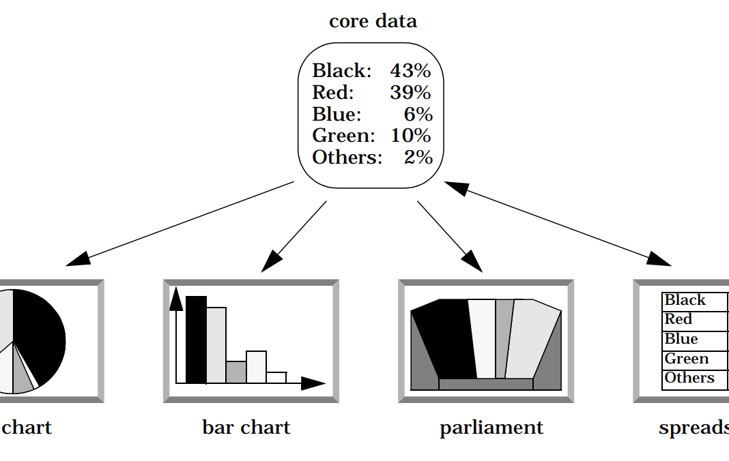
Example
Problem User interfaces are especially prone to change requests.
Extending the functionality of an application
Specific user interface adaptation
Different ‘look and feel’ standard.
Upgrading to a new release of our windowing system can imply code changes
Different users place conflicting requirements on the user interface
Easily incorporation of several UI paradigms
Building a system with the required flexibility is expensive and error prone
Notes:
Problem User interfaces are especially prone to change requests. When we extend the functionality of an application, we must modify menus to access these new functions. A customer may call for a specific user interface adaptation, or a system may need to be ported to another platform with a different ‘look and feel’ standard.
Even upgrading to a new release of our windowing system can imply code changes.
Different users place conflicting requirements on the user interface. A typist enters information into forms via the keyboard. A manager wants to use the same system mainly by clicking icons and buttons.
Consequently, support for several user interface paradigms should be easily incorporated. Building a system with the required flexibility is expensive and error prone if the user interface is tightly interwoven with the functional core.

Slide 6
Example
The following forces influence the solution:
Same information is presented differently
The display and behavior of the application must reflect data manipulations immediately
Changes to the UI should be easy
Supporting different ‘look and feel’ standards should not affect code
Notes:
The following forces influence the solution:
The same information is presented differently in different windows, for example, in a bar or pie chart.
The display and behavior of the application must reflect data manipulations immediately.
Changes to the user interface should be easy, and even possible at run-time.
Supporting different ‘look and feel’ standards or porting the user interface should not affect code in the core of the application.

Slide 7
The Classic Model-View-Controller Pattern (MVC)
In MVC pattern, model, view, controller triad exists for each object that can be manipulated by the user.
Model : Storing the domain data and their basic logic
Has no reference to the other modules
Domain data does not depend on the presentation of domain data at all
View : View is something that displays data to user.
Simple and free of business logic implementation.
Invokes methods on Controller depending on user actions.
View monitors the model for state change and displays updated model.
Controller:
Interacts with the model and performs actions that updates the model.
doesn’t mediate between the view and model.
simply process the user action and updates model
Notes:
In MVC pattern, model, view, controller triad exists for each object that can be manipulated by the user. Lets see what each of these does
The Model module is for storing the domain data and their basic logic. This module is blind and has no reference to the other modules. The domain data does not depend on the presentation of domain data at all.
View : View is something that displays data to user. In MVC pattern view should be simple and free of business logic implementation. View invokes methods on Controller depending on user actions. In MVC pattern View monitors the model for any state change and displays updated model.
Controller: Controller is invoked by view, it executes interacts with the model and performs actions that updates the model. Controller doesn’t have an idea about the changes that it’s updates on the model resulted in the view. Often misunderstood in MVC pattern is the role of Controller. It doesn’t mediate between the view and model,and its not responsible for updating the view. It simply process the user action and updates model, its the view’s job to query and get the status of the changed model and render it.

Slide 8
The Classic Model-View-Controller Pattern (MVC)
Understanding the interaction between Model, View and Controller using sequence diagram:
Notes:
A more easier way of understanding the interaction between Model, View and Controller is using a sequence diagram.
The user interacts with the user interface in some way (e.g., user presses a button)
A controller handles the input event from the user interface, often via a registered handler or callback.
The controller accesses the model, possibly updating it in a way appropriate to the user’s action (e.g., controller updates user’s shopping cart). Complex controllers are often structured using the command pattern to encapsulate actions and simplify extension.
A view uses the model to generate an appropriate user interface (e.g., view produces a screen listing the shopping cart contents). The view gets its own data from the model. The model has no direct knowledge of the view. The user interface waits for further user interactions, which begins the cycle anew.
In Classic MVC pattern Model and View are bound according to the rules of Observer pattern. This is one of the major drawback of Classic MVC pattern. The Classic MVC pattern is no longer in use today. Model2 is a popular variant of MVC pattern that is used in web applications

Slide 9
MVC Pattern for Web Applications (Model 2)
Model2 is MVC adapted to web
One of the most popular variation is Model 2
It’s a pattern originally created for Java Server Pages (JSP) and owes a lot of its popularity to Struts framework. It’s the same pattern implemented by the recent ASP.NET MVC framework in .NET technology stack.
The following diagram depicts the structure of Model2 pattern:
Notes:
Classic MVC pattern was designed when web didn’t exist and it was primarily designed for desktop applications, but the loose definition of MVC made way to different variations of MVC. Model2 is the most popular variant of MVC pattern applied to web applications, Model2 is MVC adapted to web.
One of the most popular variation is Model 2. It’s a pattern originally created for Java Server Pages (JSP) and owes a lot of its popularity to Struts framework. It’s the same pattern implemented by the recent ASP.NET MVC framework in .NET technology stack.
The following diagram depicts the structure of Model2 pattern:

Slide 10
MVC Pattern for Web Applications (Model 2)
Following sequence diagram depicts Model2 interactions using sequence diagram :
Notes:
In Model 2 pattern, all web post requests go to front controller, implemented as a http interceptor (http module in ASP.NET ),which in turn figures out the appropriate controller depending on the structure of the incoming request URL and services the request. The controller invokes a method that affects the model.

Slide 11
Difference between classic MVC and Model2
There is no direct contact between view and model in model 2.
The controller will be the one who will talk to business logic layer and update the model.
The interaction between the view and model is an indirect relationship.
MVC Pattern for Web Applications (Model 2)
Classic MVC
Notes:
The main difference between classic MVC and Model2 is that there is no direct contact between view and model. The controller will be the one who will talk to business logic layer and update the model. The interaction between the view and model is an indirect relationship.

Slide 12
Classic MVC pattern drawbacks
Classic MVC pattern has two drawbacks:
Model needs to communicate change of state to the view.
The view has complete knowledge of the model, there is no explicit contract between view and model.
Notes:
Classic MVC pattern has two drawbacks:
Model needs to communicate change of state to the view.
The view has complete knowledge of the model, there is no explicit contract between view and model, which means the view is not as passive as it should be.

Slide 13
Model View Presenter (MVP)
Model View Presenter (MVP) pattern is evolved from MVC, it tries to address the previous concerns. MVP was originally developed at Taligent, in 90’s.
The MVP pattern neatly separates the Model from the View and breaks the direct relationship between them
The View exposes a contract through which the Presenter interacts with the View.
The core of MVP is the interaction between View and Presenter.
According to Martin Fowler, you never use MVP, rather you use Passive View or Supervising Controller or both variants.
Notes:
Model View Presenter (MVP) pattern is evolved from MVC, it tries to address the previous concerns. MVP was originally developed at Taligent, in 90’s.
The MVP pattern neatly separates the Model from the View and breaks the direct relationship between them. The core of MVP is the interaction between View and Presenter. The View exposes a contract(interface in .NET) through which the Presenter interacts with the View. When users interact with the view, the view invokes a method on the presenter and the presenter performs the required task on the Model and then updates the View using the contract.
According to Martin Fowler, you never use MVP, rather you use Passive View or Supervising Controller or both variants.
Contract. A contract is the implicit agreement that one make between users and implementers of a class or interface. For instance, preconditions and postconditions (things like the relation between internal members don't need to be exposed).

Slide 14
Model View Presenter (MVP)
Model : Model in MVP represents business entities or domain model or object model of the business tier.
View : In MVP pattern, View is light weight. It should only have the UI elements and shouldn’t be aware of the model. But that is in a ideal scenario, building a real passive view is quite complex in practice, hence the implementation of MVP falls into two categories :
1. Passive View : The view is really passive, light weight. View doesn’t know the model
2. Supervising Controller The view is active, binds the view using data binding or simple code in view
Notes:
The decision to use Passive View or Supervising Controller primarily depends on how testable we want in our application to be. If testability is a primary concern in our application, Passive View might be more suitable because we can test all the UI logic by testing the presenter. On the other hand, if we prefer code simplicity over full testability, Supervising Controller might be a better option because, for simple UI changes, we do not have to include code in the presenter that updates the view.

Slide 15
Why Presenter? Why the name change?
Presenter :
The classic MVP triad diagram looks similar to MVC diagram, the noticeable difference is Controller replaced with Presenter.
The Presenter in MVP, presents user actions to the backend system; after getting the response it presents the response to the users, whereas the Controller in the MVC pattern doesn’t mediate between Model and the View, it doesn’t update the view, it just mediates between user actions and model.
Notes:
Presenter : Why Presenter? Why the name change? The classic MVP triad diagram looks similar to MVC diagram, the noticeable difference is Controller replaced with Presenter. It’s not a case of just name change. The Presenter in MVP, presents user actions to the backend system; after getting the response it presents the response to the users, whereas the Controller in the MVC pattern doesn’t mediate between Model and the View, it doesn’t update the view, it just mediates between user actions and model.
MVP became quite popular in .NET world. Though it involves significant effort in using MVP pattern to build UI applications it pays of while building large scale enterprise applications, but probably a over kill for small applications.

Slide 16
Summary
MVC:
Traditional MVC is where there is a
Model: Acts as the model for data
View : Deals with the view to the user which can be the UI
Controller: Controls the interaction between Model and View, where view calls the controller to update model. View can call multiple controllers if needed.
MVP:
Similar to traditional MVC but Controller is replaced by Presenter. But the Presenter, unlike Controller is responsible for changing the view as well.
1. Passive View
2. Supervising Controller
Notes:
The decision to use Passive View or Supervising Controller primarily depends on how testable we want in our application to be. If testability is a primary concern in our application, Passive View might be more suitable because we can test all the UI logic by testing the presenter. On the other hand, if we prefer code simplicity over full testability, Supervising Controller might be a better option because, for simple UI changes, we do not have to include code in the presenter that updates the view.
Contract. A contract is the implicit agreement that one make between users and implementers of a class or interface. For instance, preconditions and postconditions (things like the relation between internal members don't need to be exposed).
MVC is for components, MVP is for applications

Slide 17
Questions?

Slide 18
Thank You.

